Slide 1
Machine learning project
Moamen Ashour 42010600
Ahmed Khaled 42010387
Ahmed Irfan 42010718
Mohamed amjad 42010719
Kamel moustafa 42010191
Mostafa Mohamed 42010410

Slide 2
1-Supervised Learning Regression
2- Supervised Learning Classification
3- Supervised Learning Classification )Image(
4- Unsupervised Learning.

Slide 3
Introduction
The aim of this analysis is to explore the performance of various machine learning models in predicting the 'Class' variable based on the provided dataset.
Understand how different algorithms handle the given features and contribute to the Supervised Learning Regression , Supervised Learning Classification Problem , Supervised Learning Classification Problem )Image( and Unsupervised Learning task.
1-Supervised Learning Regression
Datasets Used:
AT (Ambient Temperature): The temperature of the surrounding air.
V (Exhaust Vacuum): The exhaust vacuum pressure.
AP (Ambient Pressure): The atmospheric pressure in the surroundings.
RH (Relative Humidity): The relative humidity of the air.
PE (Net Energy Output): The net energy output of the power plant.

Slide 4
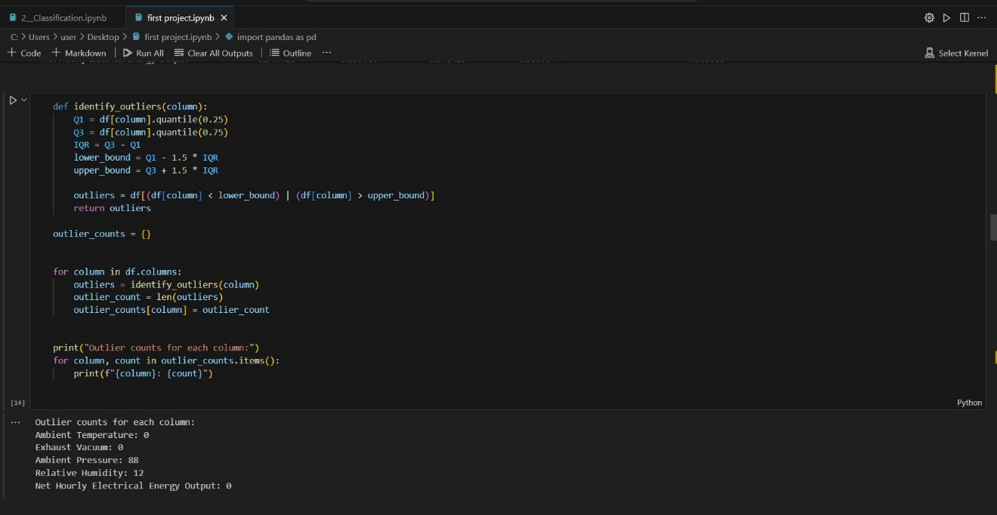
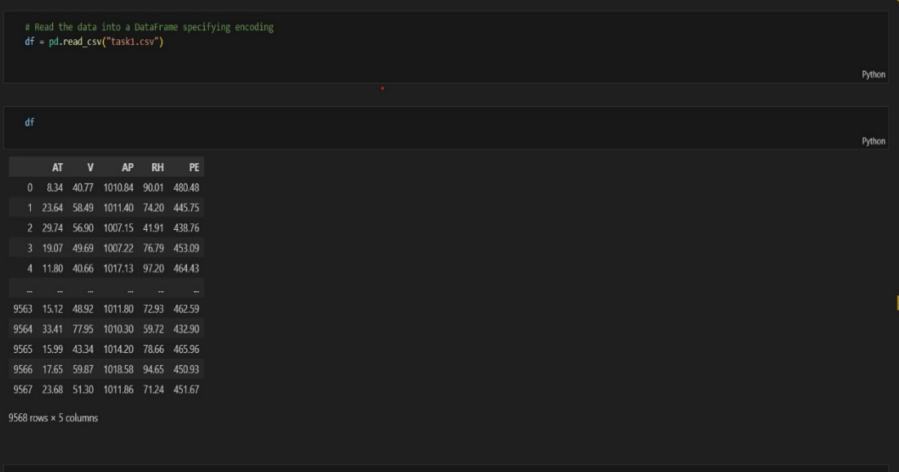
Data Exploration and Data Preprocessing
Data after remove duplicates and Handling Missing Values.
presented the introduction to the data set

Slide 5
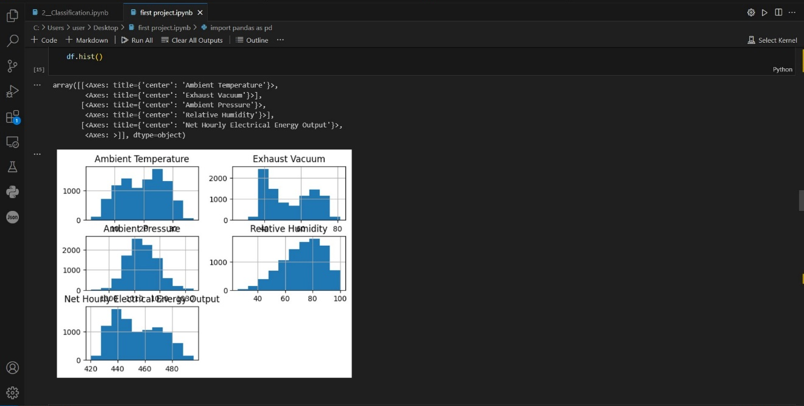
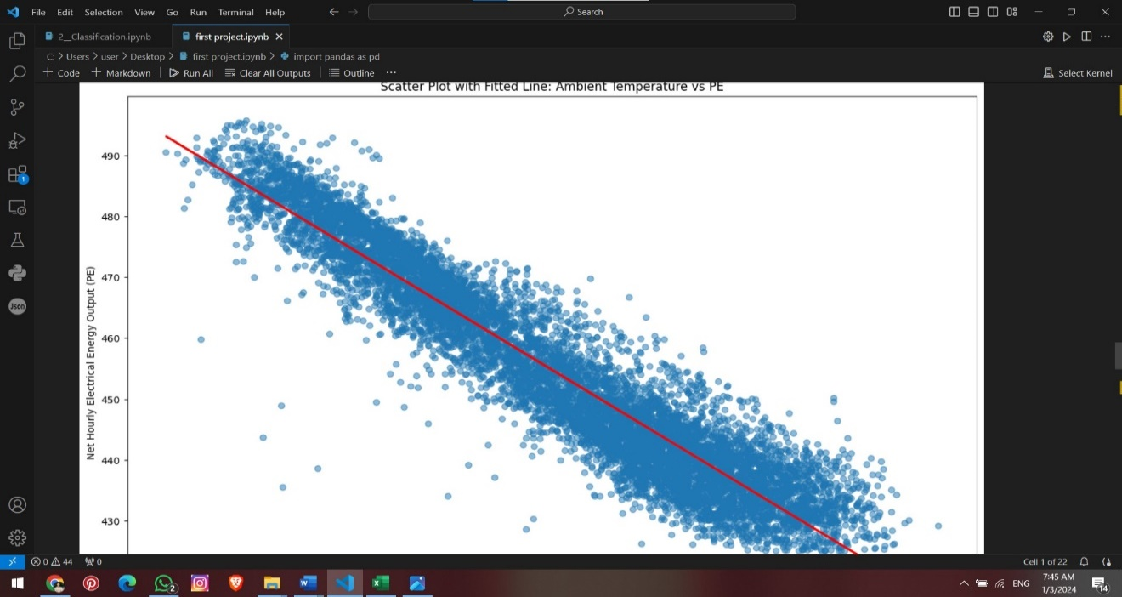
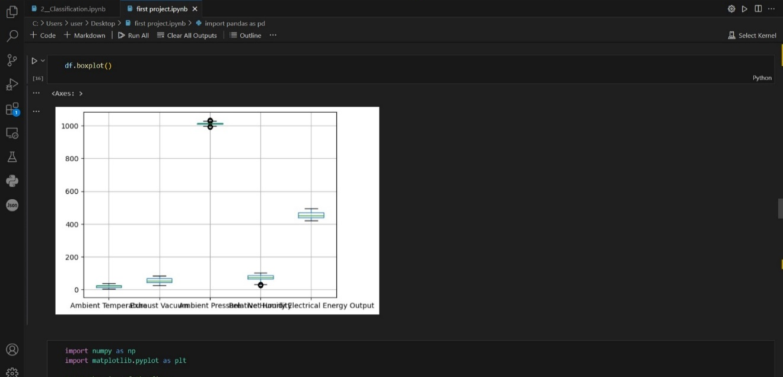
Data Visualization:

Slide 6
Machine Learning Models
1- Random forest()
2- Gradient boosting()
3- SVC()
4- Linear regression()
5- Lasso()
6- Ridge ()

Slide 7
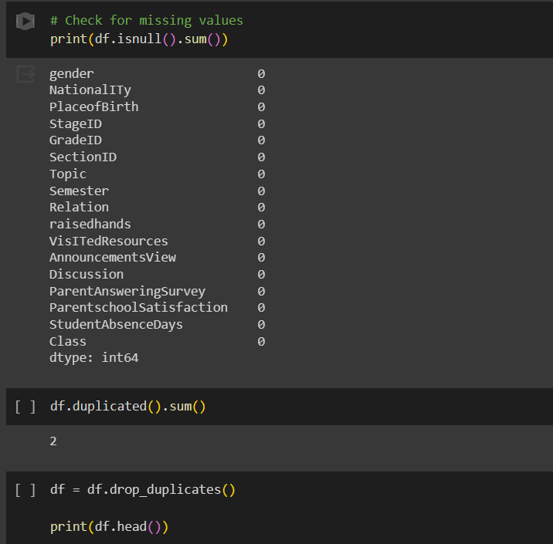
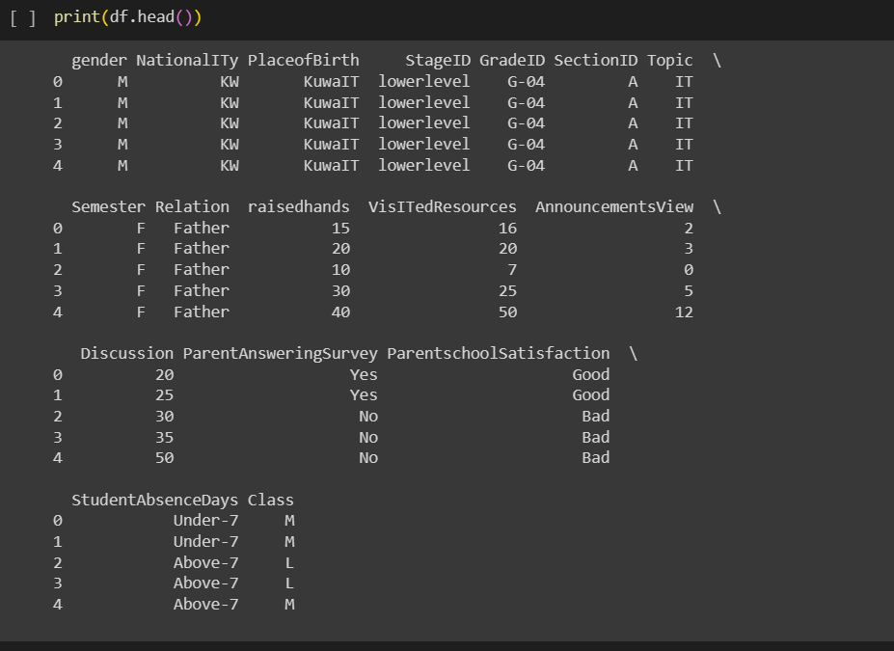
2- Supervised Learning Classification
Data Exploration and Data Preprocessing:
Data after remove duplicates and Handling Missing Values.
presented the introduction to the data set

Slide 8
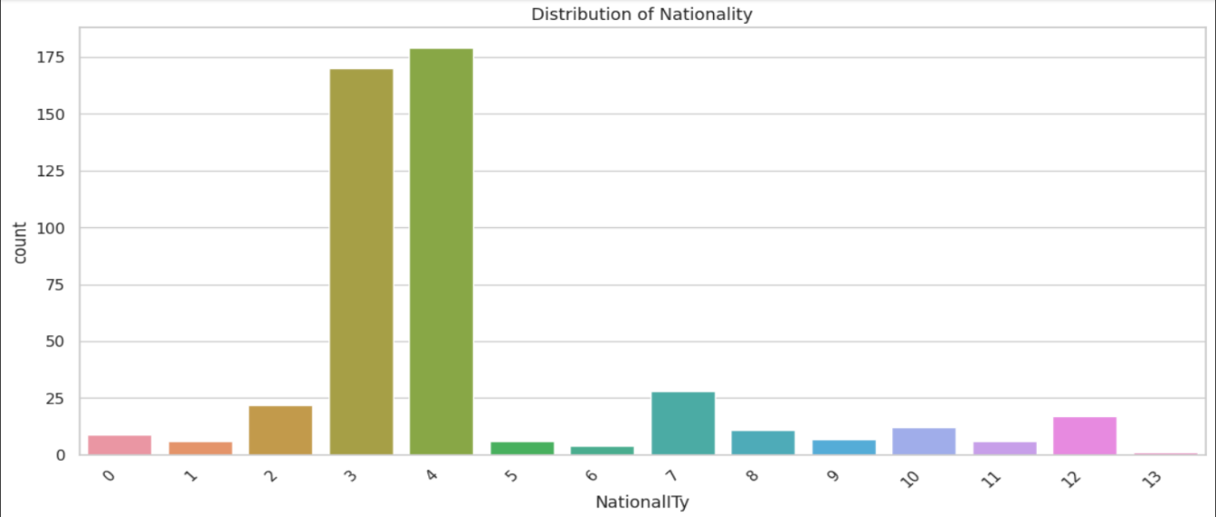
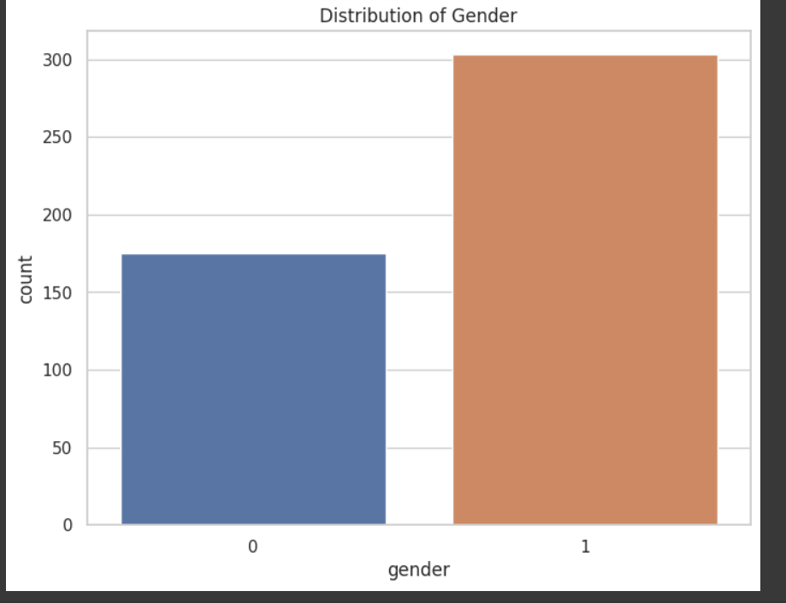
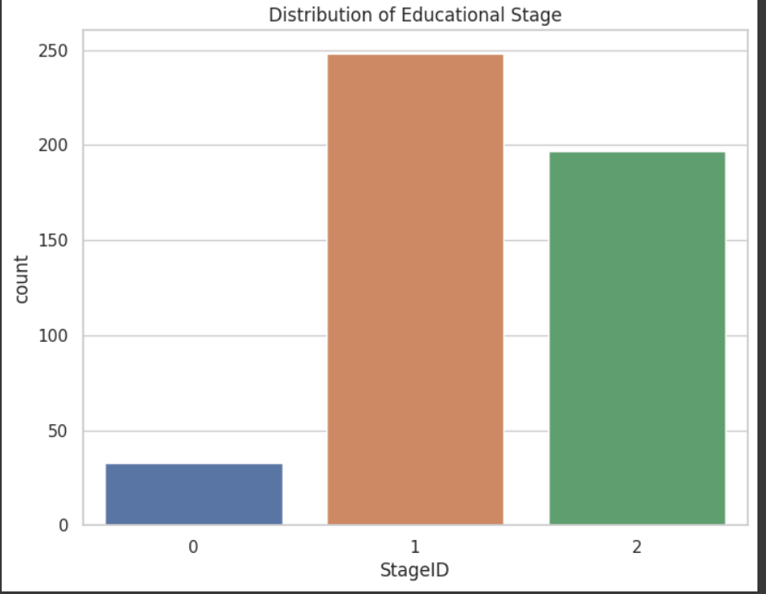
Data Visualization

Slide 9
Machine Learning Models:
1-LogisticRegression
2-DecisionTreeClassifier
3-KNeighborsClassifier()
4-GradientBoostingClassifier
5-RandomForestClassifier()
6-SVC()

Slide 10
3- Supervised Learning Classification )Image(
Overview:
The provided code defines a Convolutional Neural Network (CNN) using the TensorFlow and Keras libraries. The network is designed for image classification, specifically for identifying animals. The training is conducted using a training dataset (data_train) and a validation dataset (data_ val). After training, the model is used to predict the animal in a new image specified by the URL.

Slide 11
Data set:
A large dataset what contains a lot of images of dogs and cats.
Architecture of the Model:
Input Preprocessing
Convolutional Layer
Flatten Layer:
Dropout Layer:
Dense Layers

Slide 12
Image Prediction
The code includes a function batchImg that takes a URL, downloads an image, and processes it to be compatible with the model.
The predict function uses the trained model to predict the animal in the provided image and prints the predicted animal along with its confidence score.

Slide 13
Suggested Improvements
Model Evaluation:
  Evaluate the model on a test dataset to assess its generalization performance.
Hyperparameter Tuning:
  Experiment with different hyperparameter values such as learning rate, dropout rate, and number of units in the dense layers to optimize model performance.
Error Handling:
  Implement more comprehensive error handling, especially when handling image URLs and during the training phase.
Code Documentation:
  Include comments in the code to explain complex sections or rationale behind certain design choices.
Model Saving:
  Save the trained model after training to avoid retraining every time the script is run.
Input Validation:
Add checks to ensure that the input image size matches the expected input shape of the model.

Slide 14
4- Unsupervised Learning
Purpose of Analysis:
Explore Market Trends: Understand the temporal characteristics and trends in Bitcoin market data.
Identify Clustering Patterns: Apply clustering algorithms to identify distinct patterns within the dataset.
Time Series Prediction: Develop predictive models to forecast future Bitcoin prices.
Evaluate Model Performance: Assess the performance of clustering and prediction models.

Slide 15
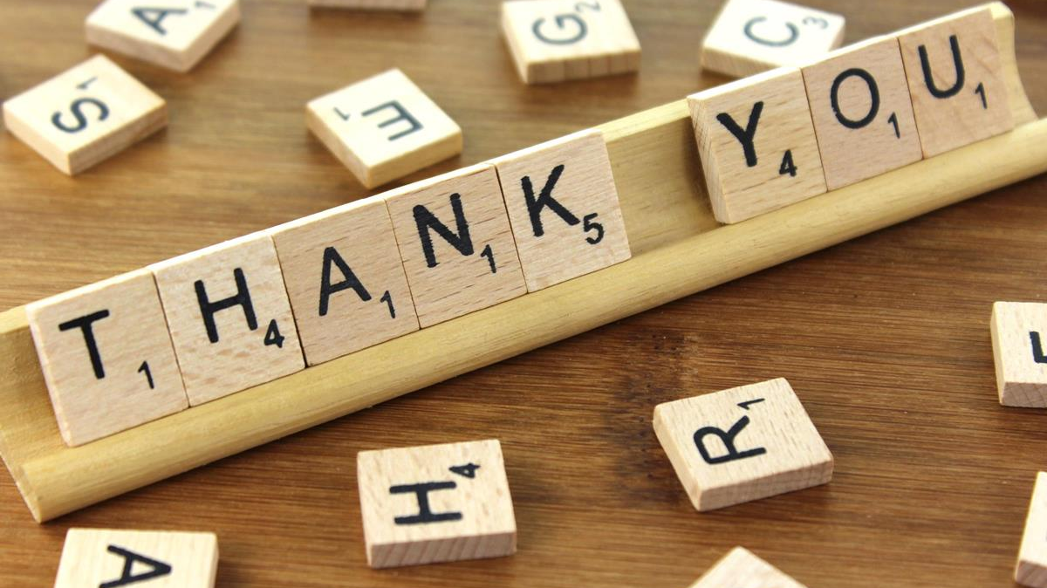
DR:ALI HAMZA
ENG:AHMED NOUSIR

